Slide 1
LARIAT CAR RENTAL PERFORMANCE SUMMARY
03.19.2020
Notes:
Presentation updated: March 19, 2020

Slide 2
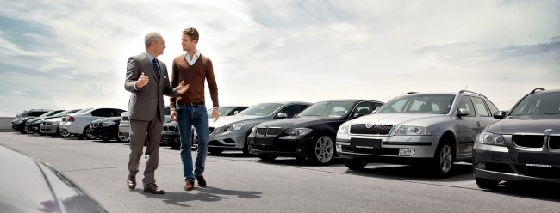
growth and success… together.
LARIAT
Notes:
Review of the mission and vision of the company.
Connection to the personal value of each employee and branch

Slide 3
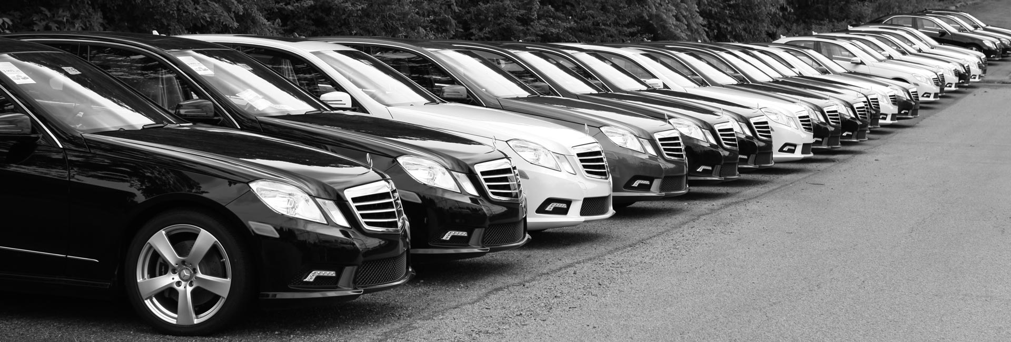
LARIAT
PERFORMANCE SUMMARY
Notes:
Review of the mission and vision of the company.
Connection to the personal value of each employee and branch

Slide 4
LARIAT TOTAL REVENUE, COST, AND PROFIT
*based on 50 locations | 4,000 vehicle fleet
Notes:
State the total revenue for the year - $64,866,040
Total cost for the year - $29,473,537
Total profit for the year – $35,392,502

Slide 5

top performers.
LARIAT
Notes:
In the following slides, we will review the top car make and the top 10 car models based on total revenue and profit

Slide 6
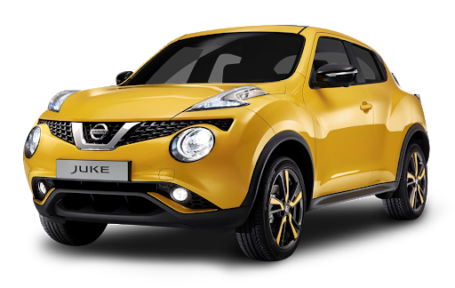
NISSAN TOTAL REVENUE, COST, AND PROFIT
114 Nissan vehicles in fleet
*based on 50 locations | 4,000 vehicle fleet
Notes:
State the car make that we are talking about – Nissan
State the total number of vehicles in the fleet – 114 Nissan Vehicles
State the revenue - $5,508,879
State the cost - $2,526,783
State the profit - $2,982,115

Slide 7
TOP 10 CAR MODELS – TOTAL PROFIT-$1,935,587
Grand Prix | $ 212,608.40
LS | $ 206,527.68
Grand Marquis | $ 203,856.16
Cabriolet | $ 195,297.24
Corvette | $ 189,667.28
Ranger | $ 189,475.40
Jetta | $ 187,956.08
Town Car | $ 187,100.96
Express 3500 | $ 185,098.04
Accord | $ 177,999.96
LARIAT
*based on 50 locations | 4,000 vehicle fleet
Notes:
1,935,587

Slide 8
growth strategies
LARIAT
Notes:
There are two growth strategies that have the potential to show some great growth for the company.
Increase the overall fleet of cars by up to 10%
Eliminate the lowest 10 performing car models and replace them with our top 10 car models
I’ll present a brief overview in the following slides

Slide 9
10% FLEET GROWTH
LARIAT
$3,539,250
A
Notes:
Increase fleet from 4,000 to 4,400
Over 9% profit increase

Slide 10
10% FLEET GROWTH
LARIAT
 | Baseline | 10% Fleet Growth
Total Revenue | $ 64,866,040 | $ 71,352,644
Total Cost | $ 29,473,538 | $ 32,420,891
Total Profit | $ 35,392,502 | $ 38,931,753
Notes:
Quick summary for a visual to compare baseline data with 10% fleet growth

Slide 11
VEHICLE REPLACEMENT
LARIAT
$1,986,226
B
Notes:
Eliminate lowest 10 performing vehicles
Replace with top 10 performing vehicles
Results in a 5.3 % increase
Just under 2 million dollars in total profit

Slide 12
VEHICLE REPLACEMENT
LARIAT
 | Baseline | Vehicle Replacement
Total Revenue | $ 64,866,040 | $ 68,267,951
Total Cost | $ 29,473,538 | $ 30,889,222
Total Profit | $ 35,392,502 | $ 37,378,729
Notes:
Remove lowest 10 performing vehicle models
Replace with top 10 performing models
Quick summary for a visual to compare baseline data with vehicle replacement

Slide 13
COMBINED STRATEGIES TOTALS
LARIAT
$3.54 million – fleet growth
$1.98 million – vehicle replacement
$5,525,477
Notes:
Overall profit increase with combined strategies
The bottom line
Additional 5 million dollars in profit
Increased profit percentage of 14%

Slide 14

Recommendations
Notes:
Start with the vehicle replacement – safe option
Get rid of what people are not driving
Get them in the vehicles they want to drive

Slide 15
DISCUSSION

